Slide 1
Screw tightening information web
Phatsorn Puttipong
MFD System Department
Sony Technology (Thailand) Co., Ltd

Slide 2
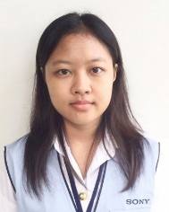
All view schedule | Screw tightening information web
Apr.
May.
Jun.
Jul.
Pic | List name | Week : | 14 | 15 | 16 | 17 | 18 | 19 | 20 | 21 | 22 | 23 | 24 | 25 | 26 | 27 | 28
 | 1. Training | Plan
 |  | Actual
 | 2. Screw tightening information web Project | Plan
 |  | Actual
 |  | Plan
 |  | Actual
 |  | Plan
 |  | Actual
 |  | Plan
 |  | Actual
 |  | Plan
 |  | Actual
 |  | Plan
 |  | Actual
 |  | Plan
 |  | Actual
Mr. Phatsorn
Plan
On process
Complete
Delay plan
2023/6/19

Slide 3
Work schedule| Screw tightening information web
Apr.
May.
Jun.
Jul.
List name | Week : | 14 | 15 | 16 | 17 | 18 | 19 | 20 | 21 | 22 | 23 | 24 | 25 | 26 | 27 | 28
2.1 Debug code & Site map | Plan
 | Actual
2.2 Design UI | Plan
 | Actual
2.3 Create table master Screw register Nijiko register Cart register Station register User register | Plan
 | Actual
2.4 Create table result Log of cart and nijiko table Log of nijiiko and station table Result torque | Plan
 | Actual
2.5 Create website for mange table ( 100% ) | Plan
 | Actual
2.6 Create website (Con.) 70% Log in page success Profile page success User manage success Dashboard | Plan
 | Actual
2.7 Re concept and config 30 % Screw Manage success Station Manage Channel Manage Nijiko Manage | Plan
 | Actual
2.8 manual Test (P’ Do) | Plan
 | Actual
2.9 Debug website & Report Improvement website Report & PPT | Plan
 | Actual
2023/6/19

Slide 4
Work schedule| Screw tightening information web
Work schedule in week 24 ( 12/6/2023 – 16/6/2023 )
Page | Function | Process
1. Profile | Connect Database | 100%
2. User manage | Connect Database + fetch data Insert / Update / Delete | 100%
3. Login | Connect Database | 100%
4. Sequence Manage (Register process) | Connect Database + fetch data Config function Insert / Update / Delete | 40%
5. Re concept and config Screw Manage success Station Manage Channel Manage Nijiko Manage | Config function Insert / Update / Delete | 30%
6. Dashboard | Connect Database + fetch data success Result Torque | 70%
On process
Complete
Delay plan

Slide 5
Work schedule| Screw tightening information web
Work schedule in week 25
Page | Function | Process
5. Dashboard | Connect Database + fetch data success Result Torque | 70%
On process
Complete
Delay plan

Slide 6
Work schedule in week 22
All Page (Last)
All Page (New)
Profile
User Manage
Screw Manage
Station Manage
Cart Manage
Nijiko Manage
Dashboard
Profile
User Manage
Screw Manage
Station Manage
Channel Manage ( Change from Cart Manage)
Nijiko Manage
Sequence Manage (New Requirement)
Dashboard

Slide 7
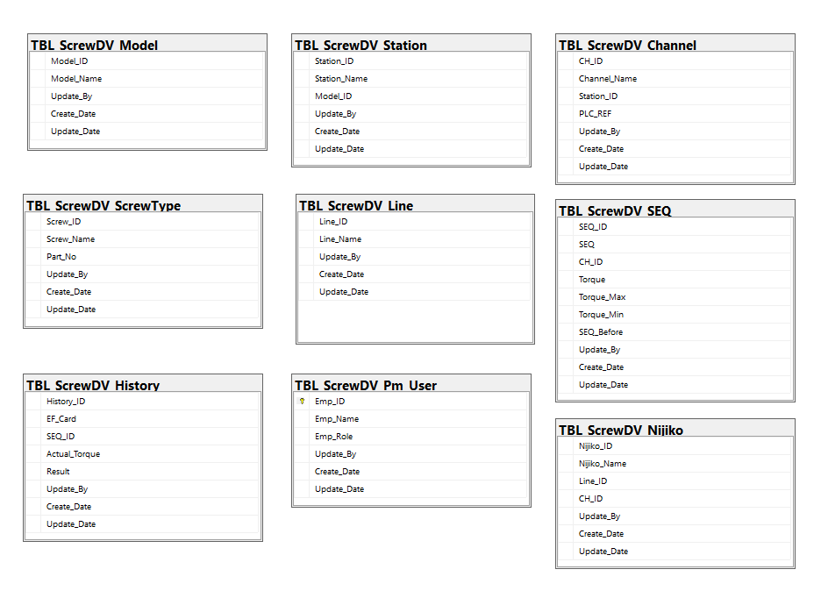
Work schedule in week 22
New Database: 9 Table

